Slide 1
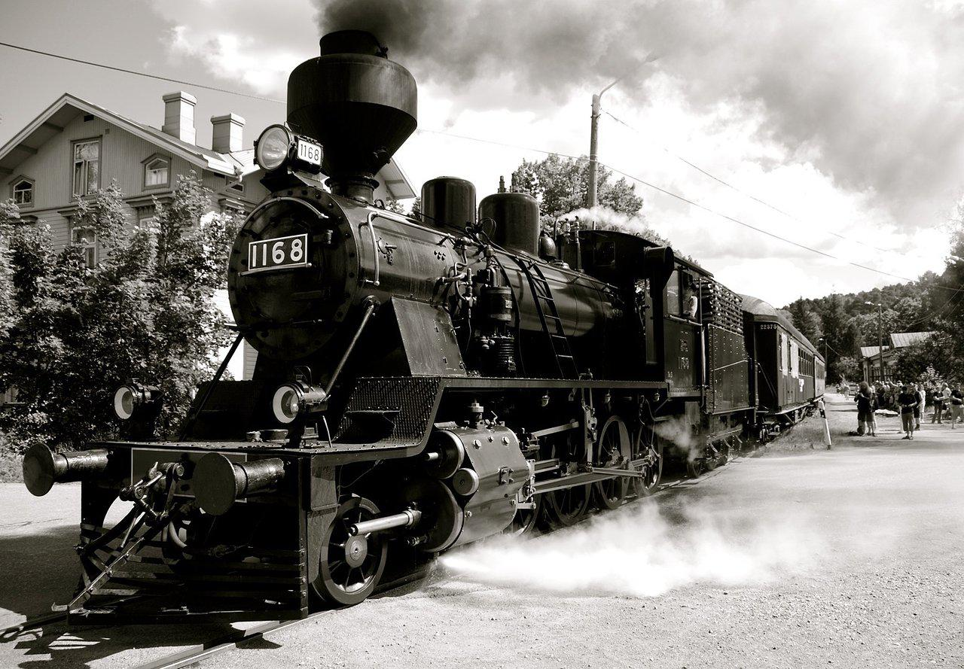
Transportation and Communication
1820-1860

Slide 2
Expansion of Business
1790
1830
1840s
Roads provided the basis of transportation within states
Rivers (Mississippi, Ohio) and canals (Erie Canal) – steamboats, barges
Railroads triumphed over canals (Baltimore-Ohio line was first)

Slide 3
Distribution of Goods
Northwest
(Cincinnati, St. Louis)
Corn, Wheat
Northeast
(NYC, Boston)
Man. goods
Southeast
(Charleston)
Cotton
Southwest
(New Orleans)
Cotton, tobacco

Slide 4
Communication and Journalism
Telegraph
Samuel F. B. Morse
(Western Union)
Seemed an ideal solution to long distance communication
Rotary Printer
Developed in 1846
Allowed newspapers to be printed quickly and cheaply
Associated Press
Multiple newspaper publishers formed AP
Promoted cooperative news gathering by wire
Journalism became an important unifying factor in American life. In the 1840-1850s it reflected the sectional conflict in US, mostly reflected Northern views (most papers in northeast)

Slide 5
Expansion of Business
Interchangeable parts
(Eli Whitney, Simeon North) – factory production
Sewing machine (Elias Howe and Isaac Singer) – availability of ready-made clothing
New sources of energy – coal (Pittsburgh), water

Slide 6
Labor Systems
1820s – 90% of Americans lived or worked on farms
Movement west People didn’t
Development of new farm machinery have to grow
Crops were less labor intensive their own food
There were 2 systems of labor:
1. Whole families moved from farm to mill (NYC,
Philadelphia)
2. Young women moved to mill (Lowell, Mass.)

Slide 7
Many New Englanders believed that women working was immoral. The mills:
- provided a safe environment
- had strict curfews
- mandatory church attendance
- fired girls for any perceived misconduct
Lowell System (1830s)
Immigrant workforce (1840s)
Rise of trade unions in major cities
(Commonwealth v. Hunt 1842)

