Slide 1
New England Colonies
Chapter 2: Transplantations and Borderlands

Slide 2
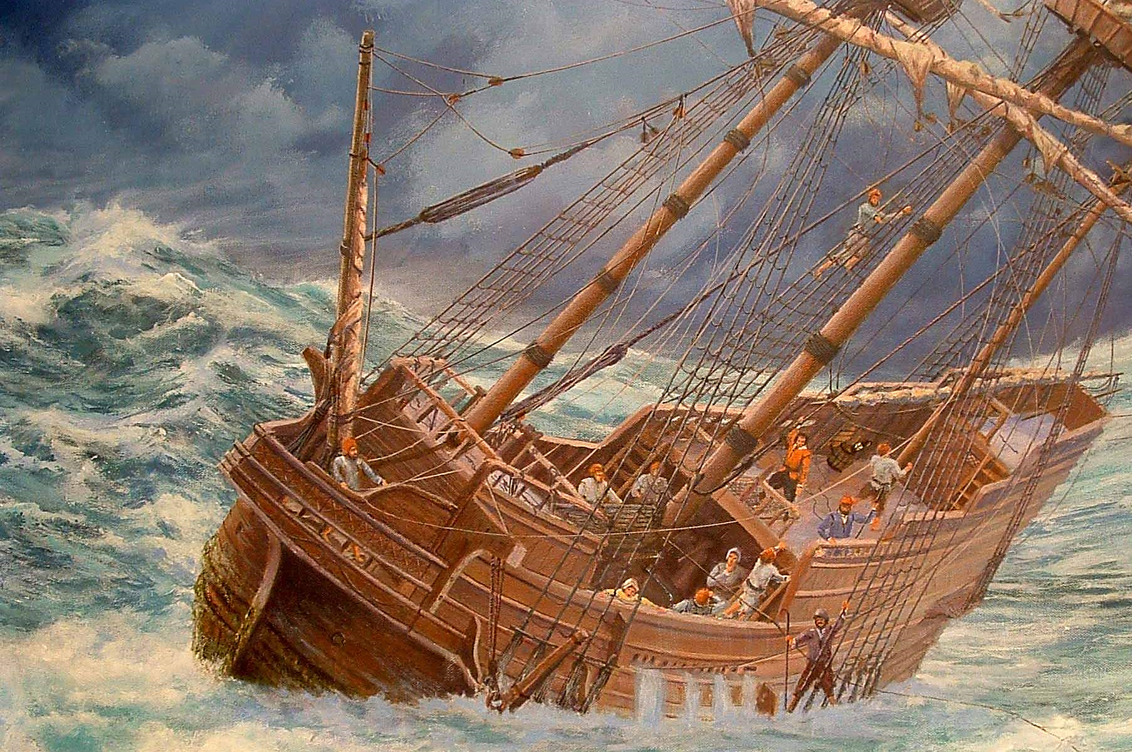
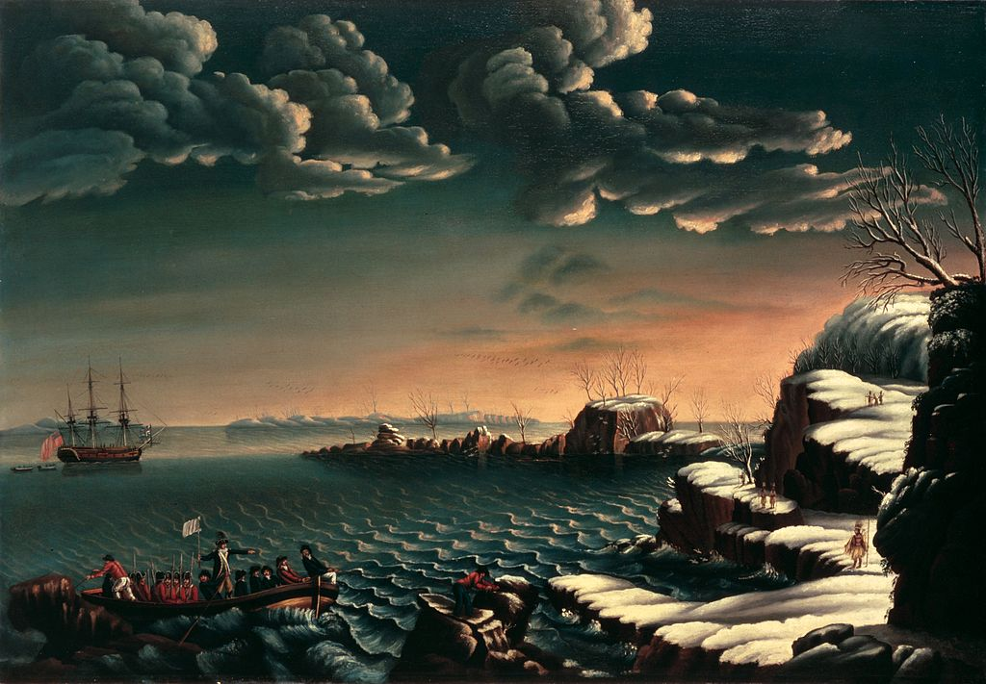
The Pilgrims
In 1620 Puritan separatists immigrated to Virginia
The journey was financed by London investors who hoped to establish a profitable trade
The Mayflower was blown of course and Pilgrims arrived in modern day Cape Cod, MA
Landing of the Pilgrims – Michele Felice Corne (1805)
Depicts the arrival of the Pilgrims in Plymouth and is displayed in the White House.

Slide 3
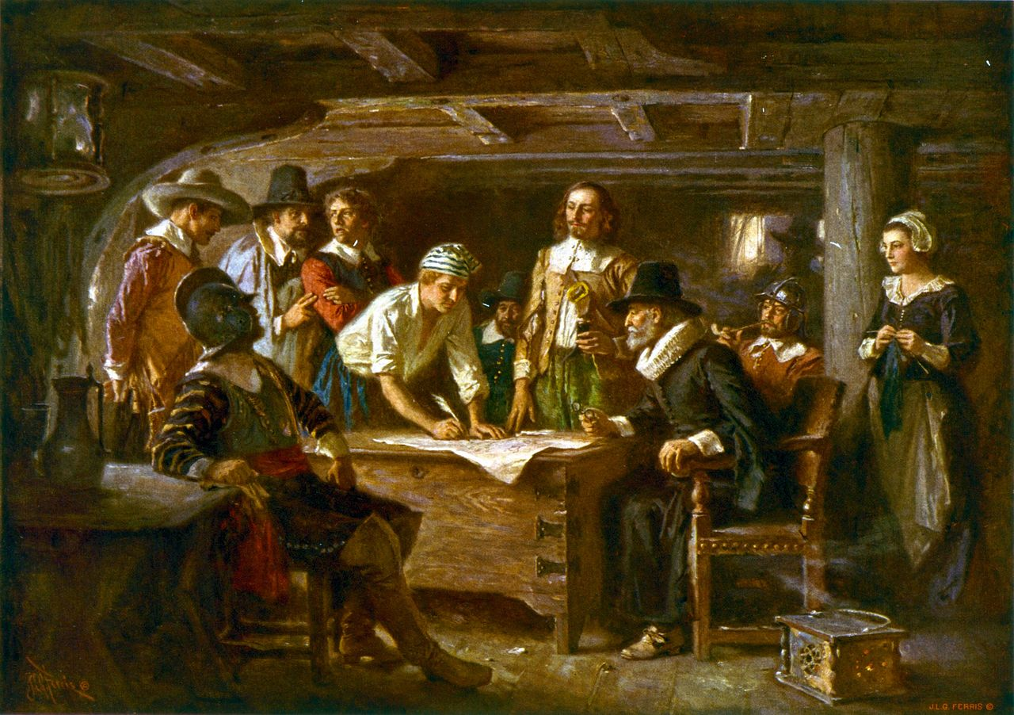
The Pilgrims
The Mayflower Compact
Realizing they were not in Virginia, the Pilgrims "would use their own liberty; for none had power to command them....“
The colonists agreed to obey “just and equal laws…as shall be thought most meet and convenient for the general good of the colony”
This is considered by historians to be the first written framework for government in the United States
Signing of the Mayflower Compact of which 41 of the 102 passengers signed (all male).

Slide 4
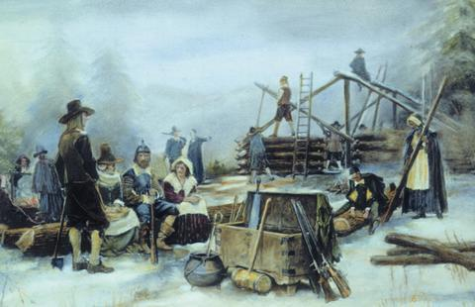
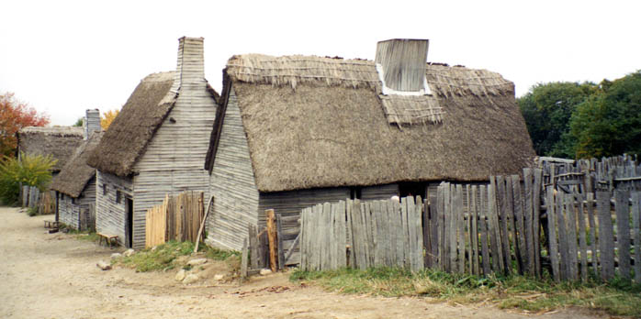
Plymouth Colony
The Mayflower arrived 6 weeks before the start of winter
Nearly ½ the passengers died during the first winter
Many passengers were inflicted with scurvy
Only 7 of a planned 19 residences were built during the first winter
Didn’t bring farm animals or food

Slide 5
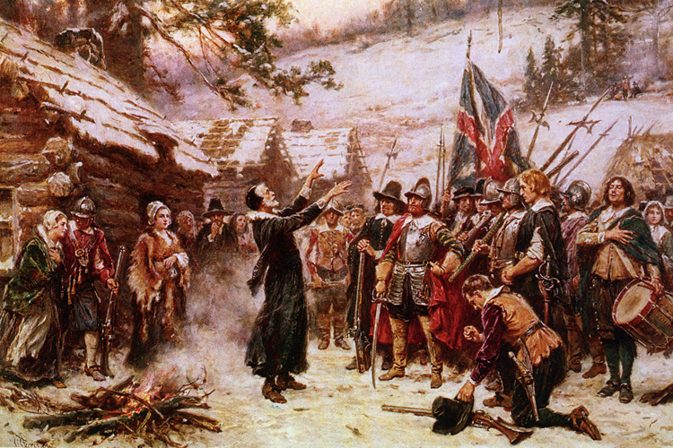
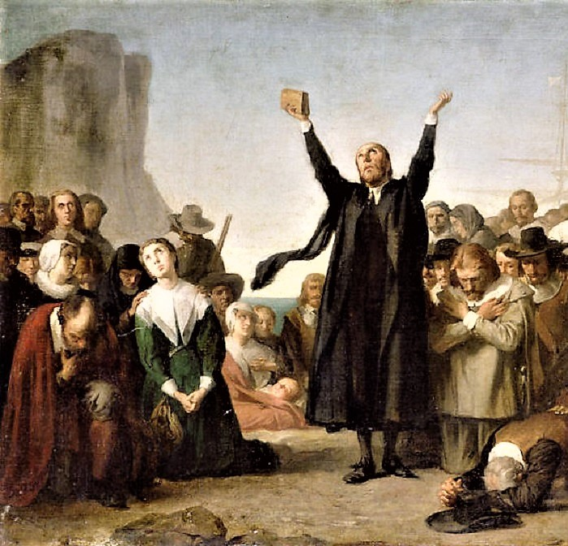
Plymouth Colony
Hoped to establish a society based on the lives of Christian saints (“city on a hill”)
Government
Principle of Consent (consensus of the majority)
Voting not restricted to church members
All land was held in common until 1627
In 1691, the Massachusetts Bay Colony incorporated Plymouth Colony

Slide 6
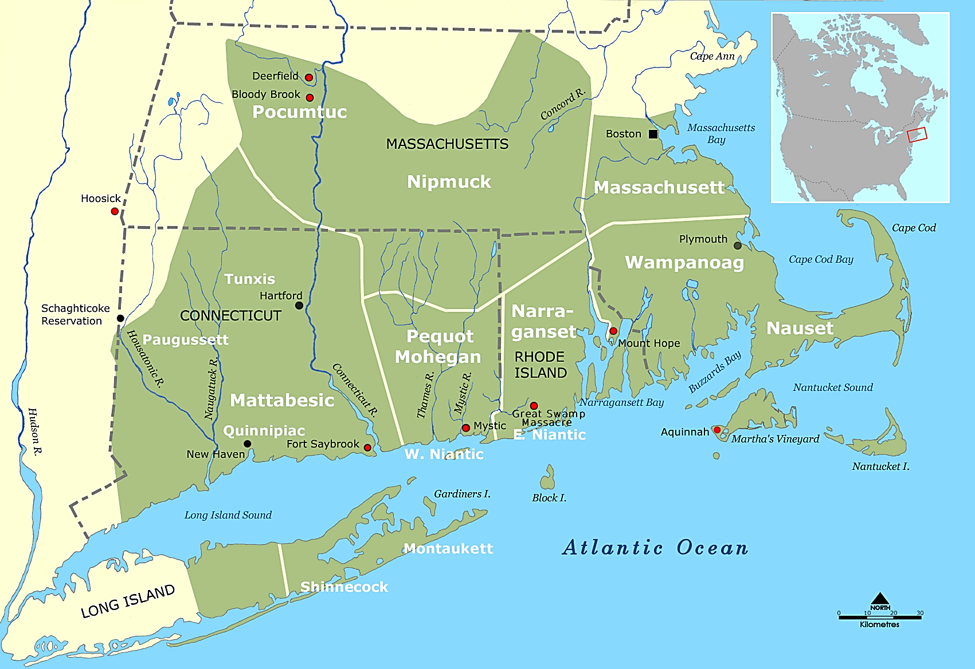
Massachusetts Bay Colony
In 1629, the Massachusetts Bay Colony was founded by London merchants hoping to earn profits by trading with Native Americans
This map shows the range of Native American tribes in the Massachusetts Bay area. The circled area is Cape Cod, where the Pilgrims first landed.

Slide 7
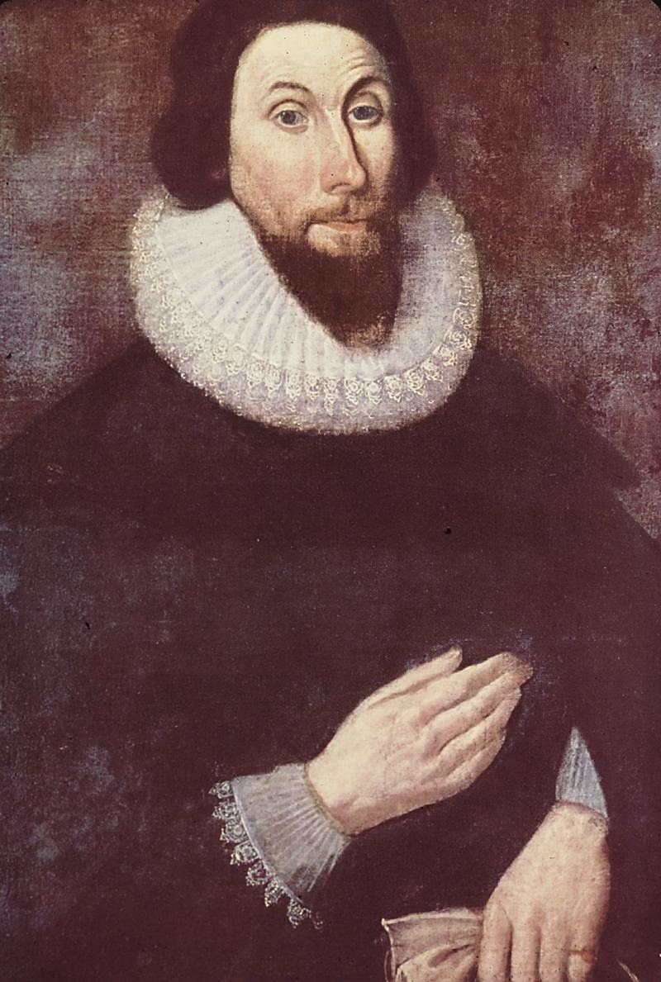
Massachusetts Bay Colony
John Winthrop
Government
Not a truly democratic society
Only full church members could be elected and vote
Visible Saint = A person who experiences public conversion, a public profession of faith, and has worldly success which confirms membership in the elect
God Almighty in his most holy and wise providence, hath so disposed of the condition of mankind, as in all times some must be rich, some poor, some high and eminent in power and dignity; others mean and in subjection

Slide 8
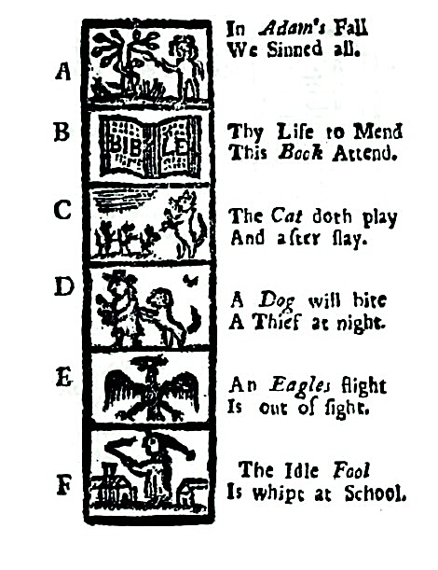
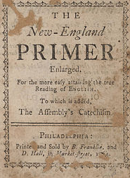
Massachusetts Bay Colony
Spiritual Equality
Women were allowed to become full church members
However, only men could be ministers
Everyone should read the Bible
Individual interpretation of the Bible was a key Puritan feature
Literacy was crucial
In 1647, a law required each town to establish a school (To this day, MA is most educated state in the US)
This catechism was found in the New England Primer, which was the textbook used in colonial American schools pre-1790.

Slide 9
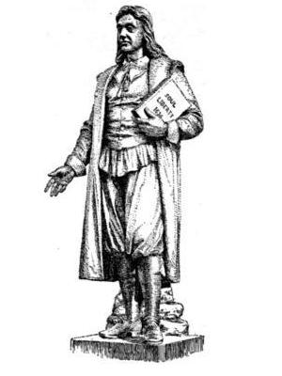
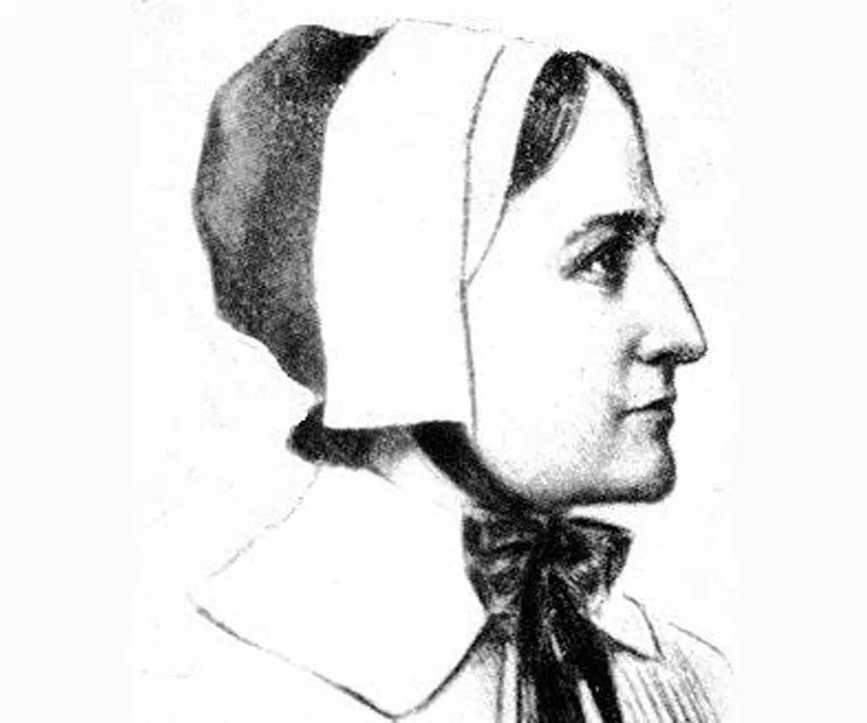
Massachusetts Bay Colony
Roger Williams
Puritans considered too much emphasis on the “self” dangerous to community stability
Roger Williams beliefs
Soul Liberty = individuals should be allowed to follow their consciences wherever they lead
Law-abiding citizens should be allowed to follow any religion (foundation for separation of church and state)
Rejected the idea of Puritan exceptionalism
Williams was banished from Massachusetts and founded Rhode Island
Massachusetts’ towns often banished individuals for criticizing the government or the church
Boast not proud English, of thy birth & blood; Thy brother Indian is by birth as Good. Of one blood God made Him, and Thee and All, As wise, as fair, as strong, as personal.
Anne Hutchinson –banished from Mass Bay for antinomian beliefs

Slide 10
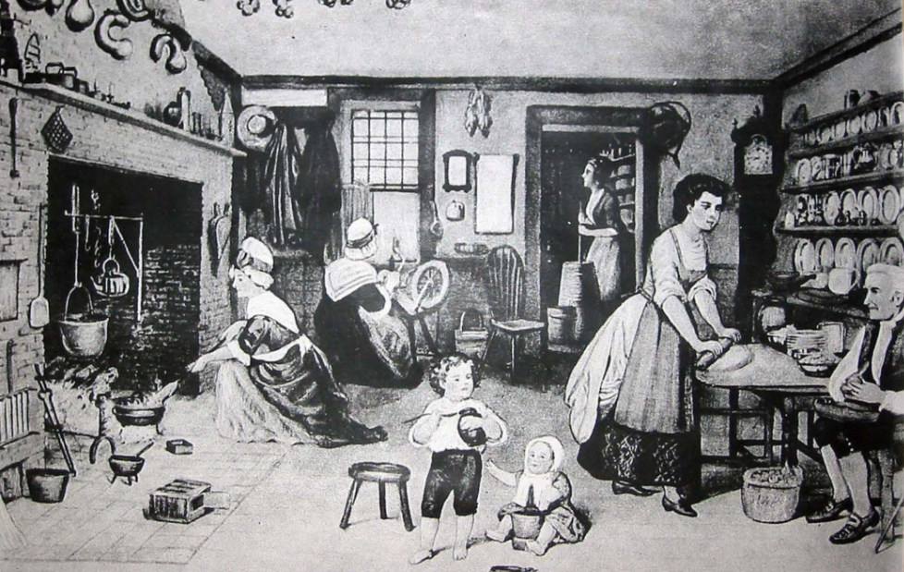
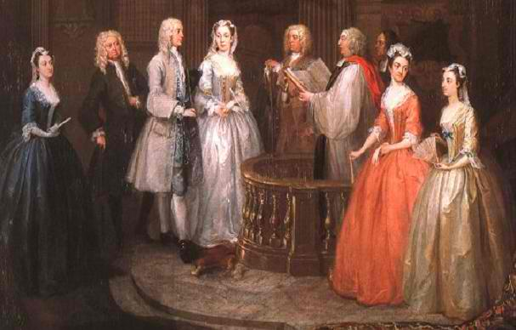
New England Statistics
Most New England settlers came as families, thus creating a more balanced gender ratio
Families
Women married at age 22 (average)
Unmarried adults seen as a danger to society
Women gave birth 7 times (average)
With relatively high child mortality rate, not all children lived to adulthood
Life Expectancy
For a 20 year old in NE, the life expectancy was around 70 years
Allowed for big families to flourish
With parents living longer, they had more authority over children due to inheritance.

Slide 11
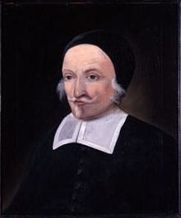
New Hampshire and Maine
Puritan clergyman who founded Exeter, New Hampshire.
Established in 1629 by royal land grant, but didn’t attract much settlement until Puritan “dissenters” moved from Mass Bay.
New Hampshire
Became a separate colony in 1679
Maine
Became a separate colony in 1820 (had previously been part of Massachusetts)

Slide 13
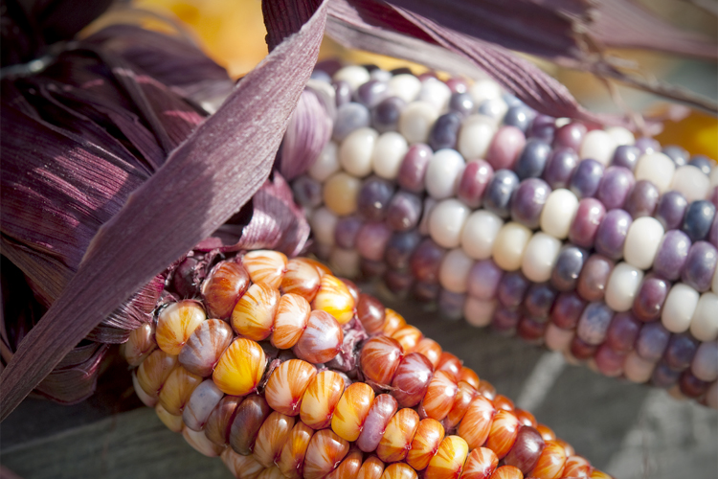
Native Americans
Native Americans were less threatening to the New England settlers than to the Virginia settlers for a number of reasons.
1. Small native population
2. Most had died from disease
3. More willing to cooperate with English (sold land, became Christians, helped with crops)
Conflict arose over
- land (cattle grazing, water rights, hunting grounds)
- destruction of property/ crops

Slide 14
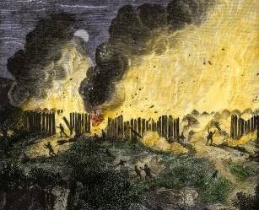
Conflict and War
1637: Pequot War
conflict between Pequot tribe and English settlers in the Connecticut Valley over land, trade
English allied with Mohegan, Narragansett tribes to attack Pequot
extreme violence by the English almost completely exterminated Pequot
1675: King Philip’s War
Chief Metacomet (called King Philip by white settlers) wanted to protect their land, culture from English encroachment and believed violence was the only way
Fought against English for over three years, attacking over 20 towns and killing thousands of people
Left a legacy of fear and hostility

Slide 15
Assessment
Identify three factors for the differences in the development of the New England colonies and Virginia
_____________________________________________________
_____________________________________________________
_____________________________________________________

