Slide 1
Virginia Colony

Slide 2
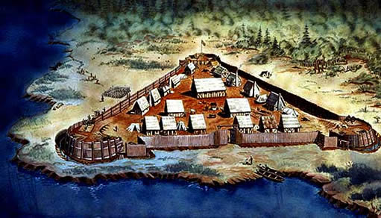
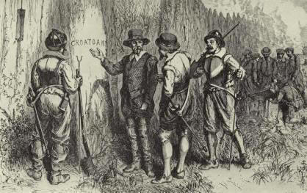
Jamestown
In 1607 Jamestown became the first successful English colony
Roanoke Island under the leadership of Sir Walter Raleigh failed. Raleigh had discovered the settlement abandoned.

Slide 3
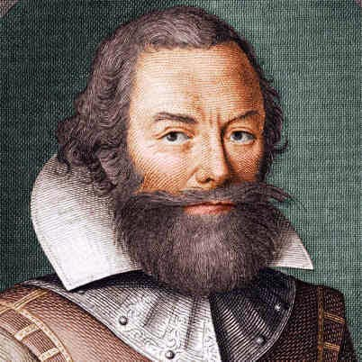
Jamestown
Founded by the Virginia Company
Goal was to make money for investors by mining gold
Who would you send to the colony?
Disproportionate number of goldsmith and jewelers sent
What necessary skill would be lacking among this group?
Agriculture
…[they] would rather starve than farm.
Captain John Smith

Slide 4
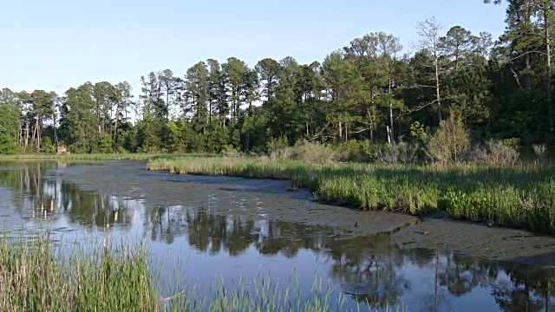
Jamestown
Swampy Jamestown presented challenges to the early settlers.

Slide 5
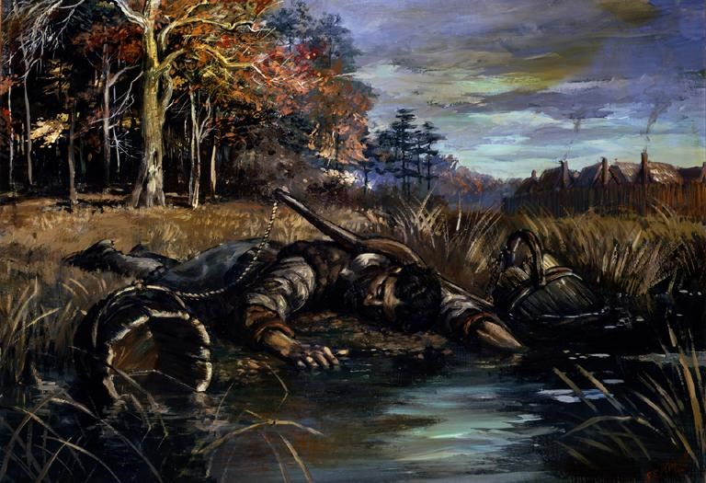
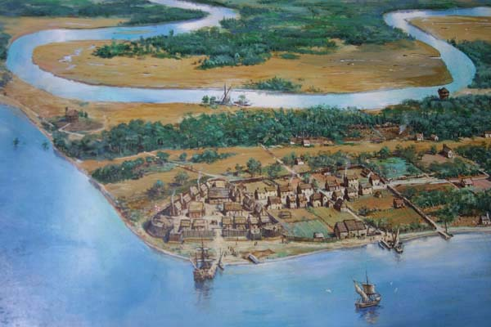
Jamestown
Conditions
Swampy area containing malaria-carrying mosquitoes
Settlers dump garbage into James River
Allowed for typhoid and dysentery
Water supply is considerable briny (only potable half of the year)
Relied heavily on assistance from Native American Indians
Statistics
Over half of the 104 original settlers died in the first year
New arrivals brought the population up to 400 in 1609

Slide 6
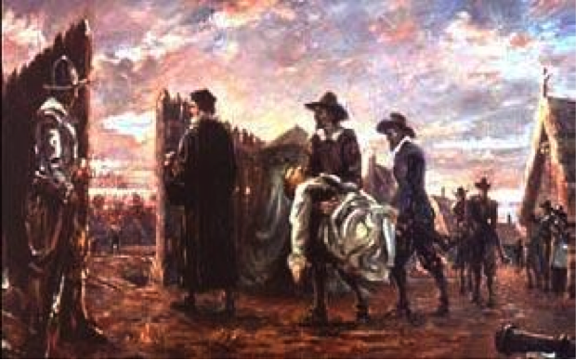
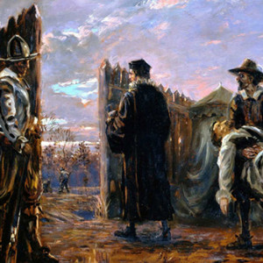
Jamestown
“The Starving Time”
During the winter of 1609 – 1610 all but 65 settlers out of 500 survive
Jamestown had experienced drought in 1609
Supply ships were delayed due to a hurricane
Trade relations with the tribes in Powhatan’s alliance had deteriorated
Settlers resorted to eating dogs, cats, rats, and even people

Slide 7
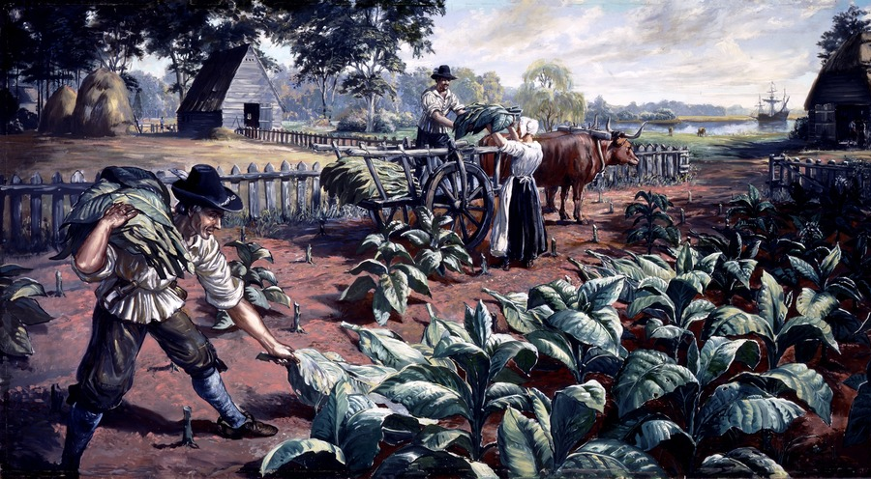
Jamestown
By 1616, roughly 80% of those who arrived in the first decade were dead
New World survival rate was 20% for the first year
Headright system
50 acres of land for each person a settler paid to bring over to the new world (including himself)
Wealthy aristocrats would bring their servants and acquire large amounts of land
Main crops included tobacco, corn, beans and squash.

Slide 8
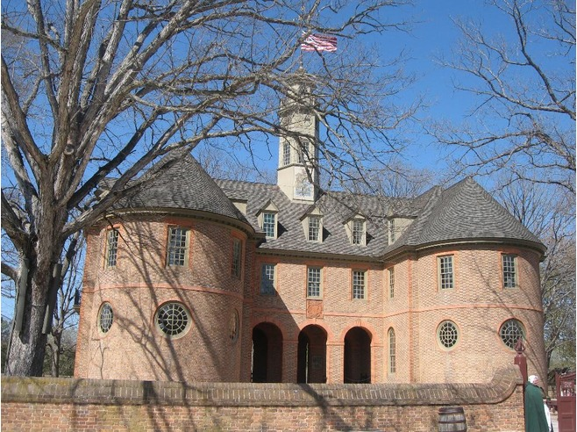
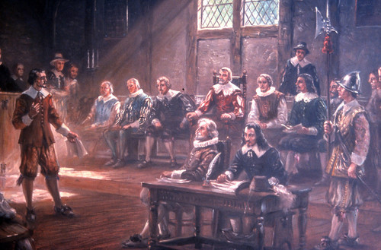
Jamestown
House of Burgesses
First elected assembly in colonial America (1619)
Not quite a democracy
Only landowners could vote
Virginia Company or its appointed governor could veto any legislation

Slide 9
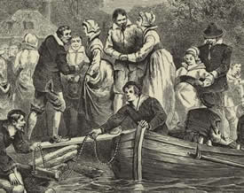
Women in Virginia
Statistics
Men outnumbered women 5:1 in first half of 17th century
Men outnumbered women 5:2 in the second half of 17th century
Most men are much older than the women of VA
Women selected older and wealthier men to marry
“Widowarchy” = Women now have authority over their finances, particularly in that widows could own property
1/5 of birth illegitimate
1/3 of women pregnant before marriage

Slide 10
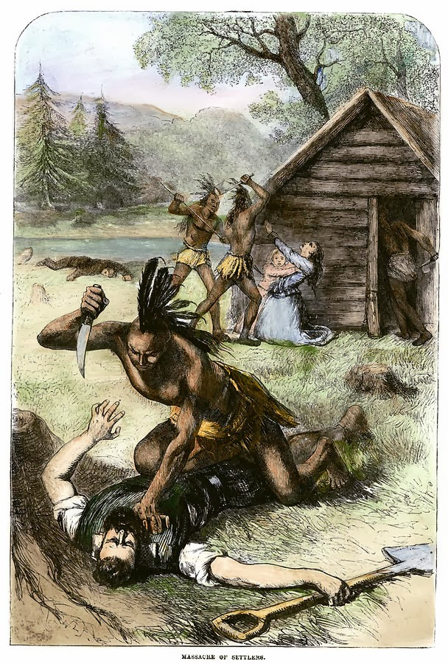
Uprising of 1622
Realizing that the English were establishing ever-expanding and permanent settlements, Indians led an uprising
In a single day, ¼ of Virginia’s 1,200 settler population was killed
VA Governor Francis Wyatt declares, “Our work is expulsion of savages to gain the free range of the country.”
Impact
Virginia Company surrenders charter – Virginia becomes a royal colony
Company had not turned a profit
Sent 6,000 settlers, but white population was only 1,200 by 1624

Slide 11
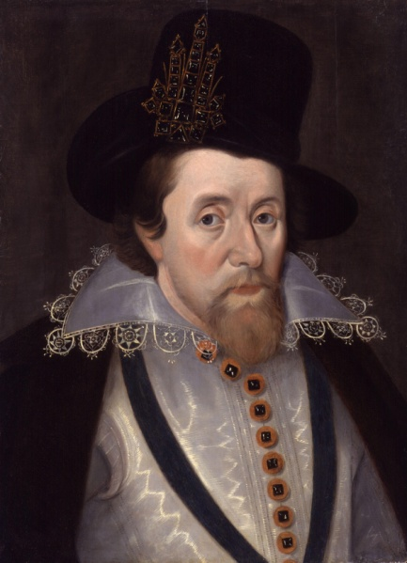
Tobacco
A custom loathsome to the eye and hateful to the nose…harmful to the brain and dangerous to the lungs.
Native Americans introduce the colonists to tobacco
Europeans consume tobacco in high numbers
The English royal government profits from taxes customs duties
1624: 200,000 lbs. of tobacco produced
1680s: 30 million lbs. of tobacco produced
King James I

Slide 12
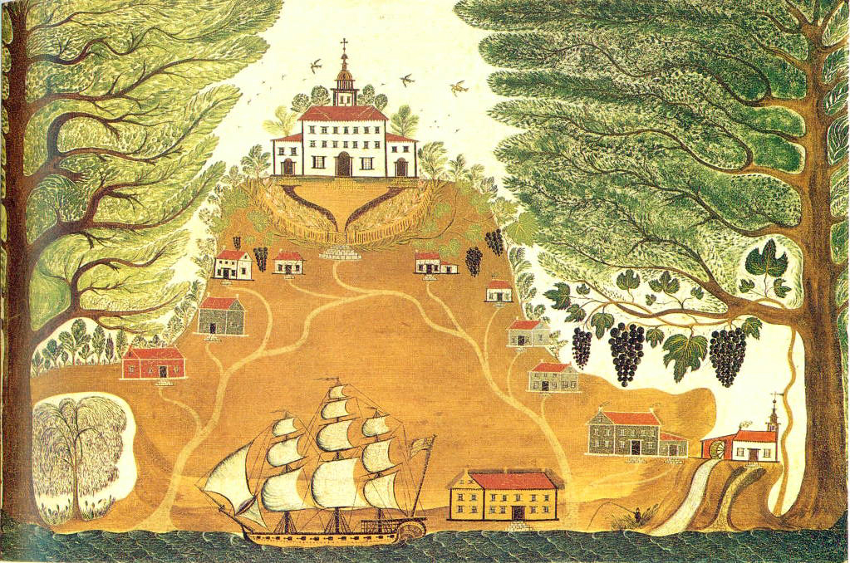
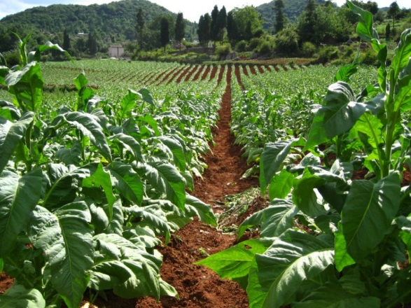
Tobacco
Need for field workers increased
Indentured servants attracted to VA
Increase in slave labor – made expansion of tobacco industry possible

Slide 13
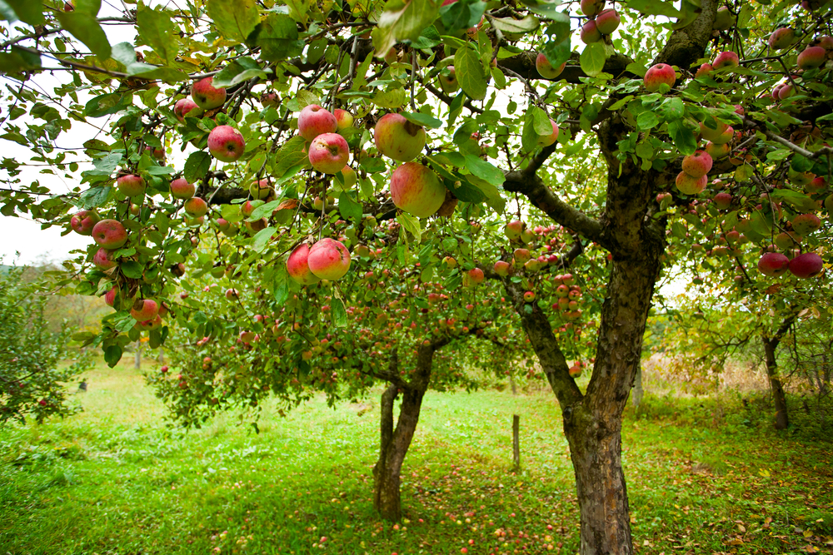
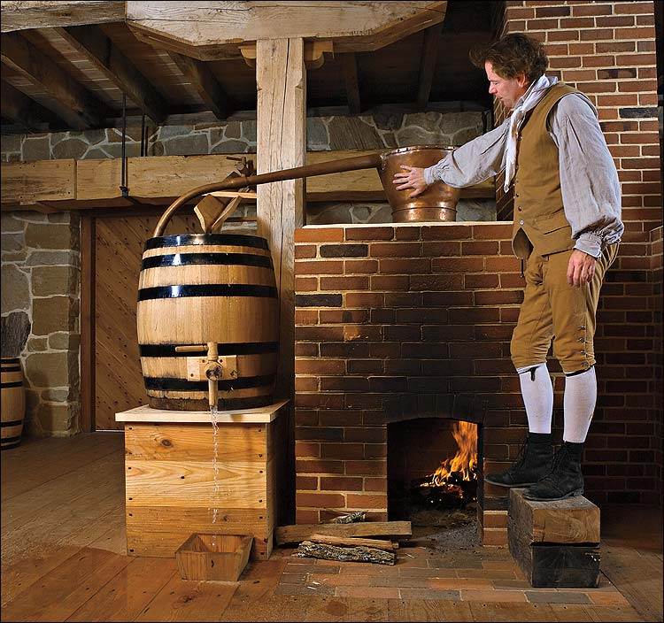
Apple Cider
Since water led to illness, many colonists brewed apple cider as a safe liquid to drink

