Slide 1
Andrew Jackson and the Changing US
The Birth of the Democratic Party

Slide 2
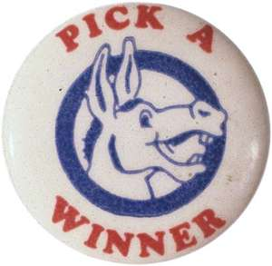
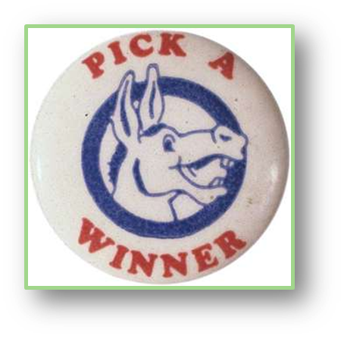
The Rise of Mass Politics
Transformation of Politics during the “Jacksonian Era”
EXPANSION OF VOTING RIGHTS
lifted the property requirement, gave all white men the franchise, gave all voters the right to hold public office
RISE OF POPULAR VOTE
voting population chose presidential electors
CREATION OF SECOND PARTY SYSTEM
Democratic party was created out of support for Jackson, Whigs in reaction to Jackson and the nativist Know-Nothings in reaction to increase in immigration

Slide 3
Expansion of the Electorate

Slide 4
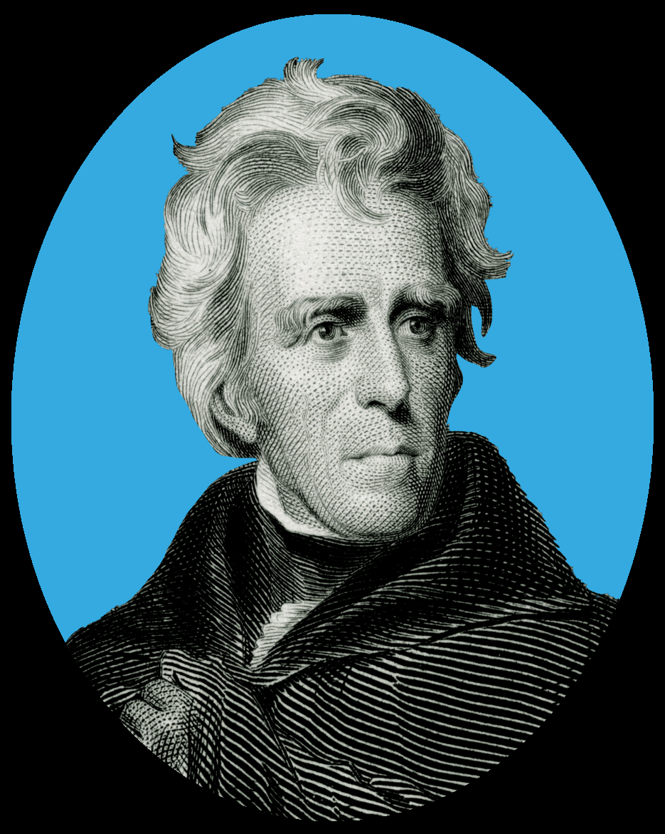
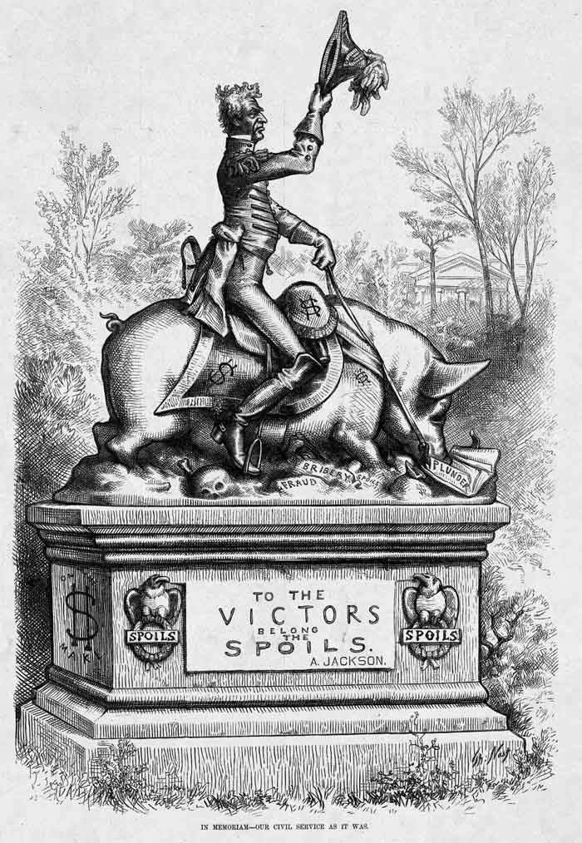
The Rise of Mass Politics
The limits of this Jacksonian political transformation
SPOILS SYSTEM (an attempt to limit ‘career’ politicians by allowing the new elected official to appoint new officeholders – “to the victor belong the spoils”)
PARTY CONVENTION (an attempt to limit the power of entrenched political elites by getting rid of the congressional caucus for appointing presidents and instead holding a national party convention)
Both of these did limit the power of the “political elite”, but didn’t necessarily increase the power of the people (esp. not as much as the Jacksonians said that it did!)

Slide 5
Key Issues of Jackson’s Presidency
Nullification Crisis
Native Americans
John C. Calhoun was faced with a dilemma in SC (state v. federal power)
Was a protectionist that supported the tariff, but his constituents did not (extremists considering secession, saw nullification as a viable alternative)
SC voted to nullify the Tariff of 1828 and 1832, Jackson saw this as treason
Henry Clay proposed a compromise, avoided military enforcement of law
Wanted Native Americans to move west, out of areas of potential white settlement
Paternalistic attitude of “noble savages” had turned hostile
Indian removal allowed access to territorial growth
Notable incidents: Black Hawk War; Indian Removal Act; Trail of Tears; Seminole War
Did not consider real alternatives – cultural dismissal allowed white settlers to justify their actions
Incident (and the potential violence) made it clear that no state could defy a federal law

Slide 6
Trail Of Tears (1830-1838)
Cherokee were moved to reservations in North Carolina
“Five Cvilized Tribes” moved from South to western land “far from white settlement”
Resistance from a band of Seminoles (led by Osceola and helped by runaway black slaves) meant that the tribe was never fully relocated to reservations (Seminole War)

Slide 7
Key Issues of Jackson’s Presidency
Bank War
Bank War
The Bank was a powerful national institution, but there was opposition
“Hard money”: believed that only gold and silver were actual currency, didn’t support the idea of bank notes, suspicious of expansion and land speculation
“Soft Money”: wanted more money in circulation, encouraged use of unsupported bank notes, upset that the BUS limited the amount of state-issued bank notes, believed in rapid growth and land speculation
The bank was a major issue in 1832 presidential election – Jackson won and was determined to close the BUS
Didn’t have authority to shut it down so he removed deposits and put them in state (“pet”) banks
This started a war between Biddle and Jackson in which Jackson ultimately won – charter was not renewed in 1836 and the BUS was done
Older, more conservative – supported by Jackson
State bankers and allies

Slide 8
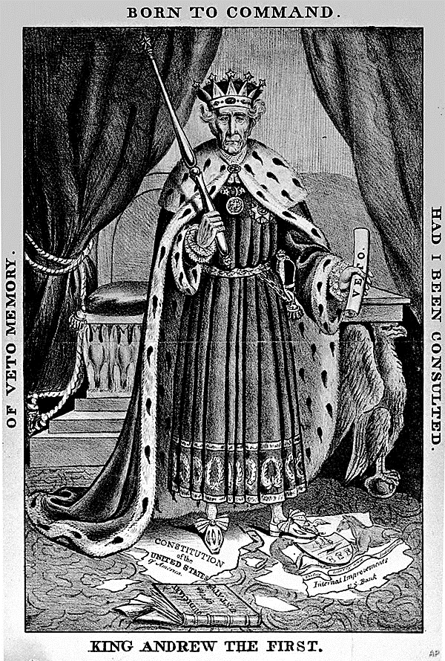
Jackson’s Legacy
Positives
Negatives
Expanded electorate and increased political participation
Changed the established system of “entrenched political elites”
Revived spirit of party politics that contributed to growth of democracy (seen as part of “checks and balances”)
Reaffirmed the strength and power of the national government with his handling of the nullification crisis
Identified with “common man” over wealth and privilege
Political decisions often based on personal vengeance
Subjugation of Native Americans (ignoring SCOTUS ruling in favor of Cherokee)
While Jacksonian Democracy was an authentic democratic movement, it was limited to only white men
Was a slave owner and upheld slavery and the plantation system
Referred to as “King Jackson” for his use of presidential power

Slide 9
Changing American Politics - Whigs
Whigs were an oppositional party to Jackson’s Democrats (named after the party in England that had traditionally worked to limit the power of the king – in this case, “King Andrew”) – see comparison chart handout for party politics
Couldn’t agree on a candidate for 1836 election (Martin Van Buren won), but brought new type of political campaigning techniques for 1840 election
“Penny Press” - cheap, tabloid-style newspapers mass-produced and available for a penny carried daily political news
Mass voter appeal, simple messages, campaign slogans (“Log Cabin campaigning”)
Harrison (Whig) won, but died of pneumonia a month after taking office
John Tyler (VP who took over after Harrison’s death) didn’t stick to Whig values and veered more toward Democrats. Caused a party split.

Slide 10
The Log Cabin Campaign of 1840 Whigs, eager to deliver what the public wanted, took advantage of this and declared that Harrison was "the log cabin and hard cider candidate," a man of the common people from the rough-and-tumble West. They depicted Harrison's opponent, President Martin Van Buren, as a wealthy snob who was out of touch with the people. In fact, it was Harrison who came from a wealthy, prominent family while Van Buren was from a poor, working family. But the election was during the worst economic depression to date, and voters blamed Van Buren, seeing him as unsympathetic to struggling citizens. Harrison campaigned vigorously and won. After giving the longest inauguration speech (about 1 hour, 45 minutes) in U.S. history, Harrison served only one month as president before dying of pneumonia on April 4, 1841.

