Slide 1
American Culturalism
The 19th century started with “a crusade against ignorance” and led to the creation of a national American identity, the geographic expansion of the United States and a spiritual reform movement based on developing a “benevolent empire”.
1800-1815

Slide 2
Expansion of the US during the Age of Reform

Slide 3
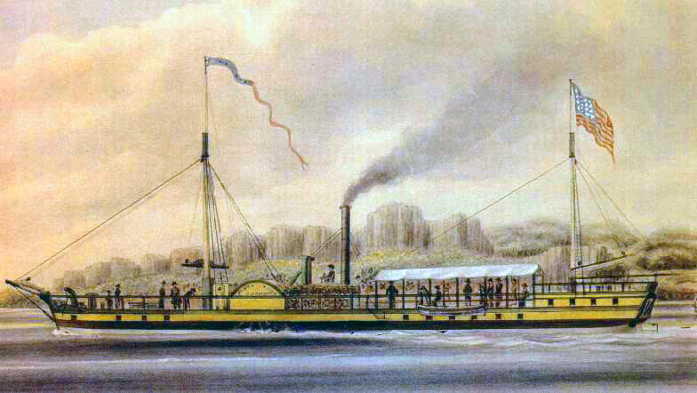
Internal improvements
1800: Population growing quickly (5.3 million in US)
US gov wanted to start expanding and needed new transportation systems
- Tennessee, Kentucky and Ohio (1803) were added as states and weren’t
connected easily to rest of US
- wanted to open roads, build canals, build turnpikes
- sold western lands to create government money
1807: Introduction of first working steamboat, the Clermont (Robert Fulton)
- allowed for faster travel/trade along waterways (Mississippi River)

Slide 4
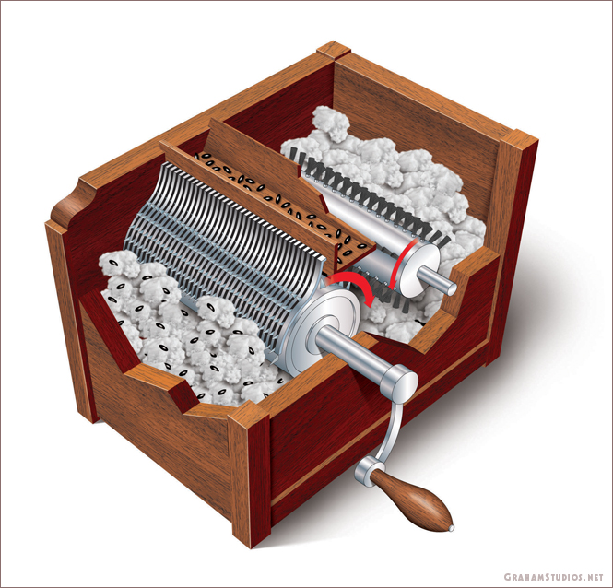
Industrial Revolution
Falling land and transportation prices, along with increased foreign demand for eastern ship and western agricultural products led to an improvement in US economy.
Needed faster, more efficient ways to work and produce goods. New inventions did this:
* Flour Mill (Oliver Evans)
* Interchangable Parts (Eli Whitney)
* Cotton Gin (Eli Whitney)
* Mass-produced clocks
* Samuel Slater and the first factory system (textile mill)

Slide 5
Commerce
The US was trying to break foreign dependence and discover new markets for goods.
Banking system became more important (over 200 banks by 1812)
States were granting charters to corporations and encouraging growth by reducing risks for those who invested in these businesses (limited liability corporation, or LLC)
Prolonged period of war between Britain and France meant more money for US businesses selling grain, flour, timber (until Jefferson’s embargo in 1807). The US would eventually expand to Pacific Islands and China

Slide 6
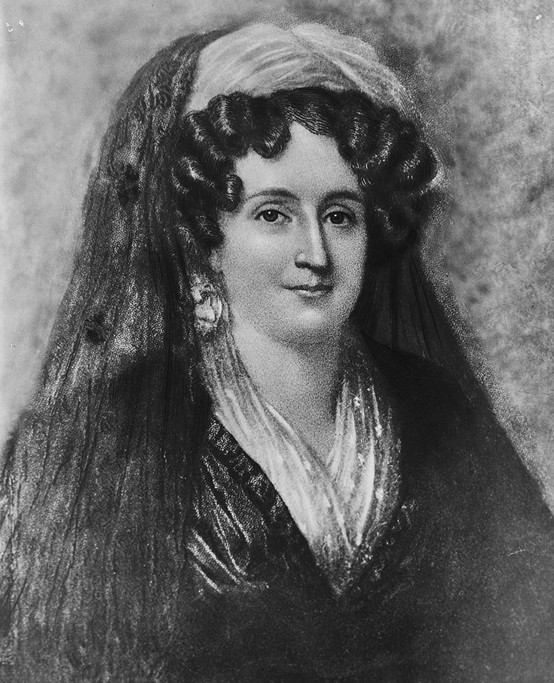
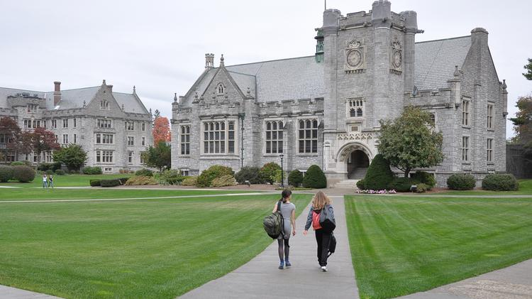
Women
Emma Hart Willard was an American women's rights activist who dedicated her life to education. She worked in several schools and founded the first school for women's higher education, the Troy Female Seminary in Troy, New York.
While laws protecting women and extending rights didn’t change, many women (especially middle class women) started to seek change themselves.
Had fewer children (6-7 by 1800 instead of 8-10 in the 1750s)
Married later in life and began to seek relationships based on love and companionship, rather than economics and social standing
Education became more important, though it was still primarily for boys rather girls

Slide 8
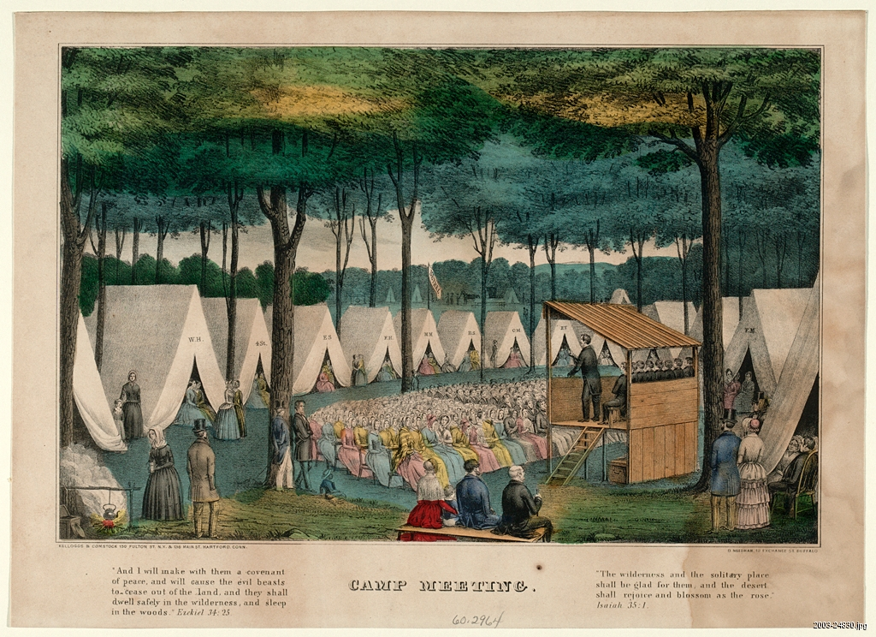
Second Great Awakening (1790s-1820s)
This was a religious movement similar to the First Great Awakening, but instead of occurring primarily in the Northeast, it was mostly in the South and West.
Lyman Beecher (father of Harriet Beecher Stowe – wrote Uncle Tom’s Cabin) was the leader of the movement
Preached against predestination and in favor of free will
Built on the discussions of equal opportunity and criticized the Catholic and Episcopal churches as places of wealth and privilege – encouraged involvement of women, African Americans and Native Americans
Brought about new denominations of Protestant Christianity such as Presbyterians, Baptists, Quakers, Methodists

