Slide 1
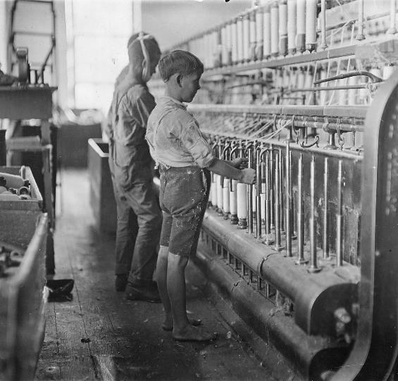
The Rise of Industrial America
Economic Expansion
from 1865-1900

Slide 2
The “Forgotten Presidents”
Rutherford B. Hayes (1877-1881)
James A. Garfield (March 4, 1881 – September 19, 1881)
Chester A. Arthur (1881-1885)
Grover Cleveland (1885-1889), (1893-1897)
Benjamin Harrison (1889-1893)

Slide 3
The United States by 1900
Leading industrial power in the world
Produced more than all European powers
Wealth of natural resources
Tremendous labor supply
Increasing population
Large investment of capital
Extreme ingenuity and productivity
More than 400,000 patents filed from 1860-1900
Business-friendly government policies
Subsidies, land-grants, loans, and protective tariffs
A new class of entrepreneurs
Notes:
Graph: http://en.wikipedia.org/wiki/Economic_history_of_the_United_Kingdom

Slide 4
The Business of Railroads
Increase in RR following the Civil War
Created:
Mass production
Mass markets
Mass consumption
Economic specialization
Impact:
Growth of related industries:
Coal, steel, travel and transportation
Time zones (1883)
Boom in stockholder corporations
Other Developments
Technology and Safety
Airbrakes, telegraphy
Government Subsidies
Notes:
Map: http://users.humboldt.edu/ogayle/hist111/industrial.html

Slide 5
Railroad Expansion
Eastern Trunk Lines
Consolidation of competing RR
Vanderbilt’s New York Central (1867)
Baltimore and Ohio, Pennsylvania RR
Western Railroads
Impact of Federal Land Grants
Homestead Act (1862)
Pacific Railway Act (1862)
Transcontinental Railroads
Central Pacific and Union Pacific
CA’s “Big Four”
The Southern Pacific
Atchison, Topeka, and Santa Fe
Northern Pacific
Notes:
Map: http://claver.gprep.org/fac/sjochs/historical-blank_maps_for_quizzes-.htm

Slide 6
Competition and Consolidation
Investments lead to over-speculation and corruption
Jay Gould
Overexpansion and stock-watering
RR companies begin to offer rebates and kickbacks to maintain competition
Offers for large companies, punished small farmers
Formation of pools
Fixed rates
Panic of 1893
25% of all RR bankrupt
Rise of JP Morgan
Consolidation = elimination of competition
By 1900, seven companies controlled 2/3 of RR
Notes:
Cartoon: http://commons.wikimedia.org/wiki/File:Jay_Gould's_Private_Bowling_Alley_-_Opper_1882.jpg

Slide 7
Industrial Empires - Steel
Impact of the Bessemer Process
Carnegie Steel
Vertical Integration
Assume/purchase all parts of the process
Andrew Carnegie
Scottish immigrant
Started in telegraphy and RR, used profit to form Pittsburgh steel industry
Sold to Morgan in 1900 for $400 million, became US Steel
US Steel
First billion-dollar company
Employed over 168,000 people
Controlled 3/5 of all steel production
Notes:
Harper’s Weekly, 1901

Slide 8
Oil Industry
First oil discovery – Edwin Drake, Titusville, PA (1859)
Boom in drilling as a result of demand
John D. Rockefeller
Standard Oil Company
Horizontal integration and predatory pricing
By 1881, owned 90% of all refineries
Formation of trusts (consolidation of corporations under the management of trustees)
One of US’s wealthiest and most controversial men in the late 1800s
Notes:
Image: http://explorepahistory.com/imagegallery.php?gallery_id=1-7-3A&bcolor=Red&display_image=1&imgId=1-2-1936

Slide 9
Laissez-Faire Capitalism
Conservative Economic Theories
Adam Smith, The Wealth of Nations
“invisible hand”
Laws of supply and demand
Impact of monopolization
Argument for:
Maintained high-quality, consistent product
Argument against:
High price to consumers and allowed for inferior products (non-competition)
Social Darwinism (Spencer)
Darwin’s natural selection applied to economics (used to justify the status quo)
Gospel of Wealth (Carnegie)
Responsibility of the wealthy to give back – civic philanthropy
Over $350 million for libraries, universities, and other public institutions
Notes:
Cartoon: http://www.libraryhistorybuff.com/carnegie-175th.htm

Slide 10
Impact of Industrialization
The Concentration of Wealth
By 1890’s, 10% controlled 90% of the nation’s wealth
The New Class of Multi-millionaires
Vanderbilt, Morgan, Carnegie, Rockefeller
Mansions, yachts and lavish parties
Wealthy neighborhoods
Park Avenue (NY)
Gold Coast (Chicago)
Nob Hill (SF)
Horatio Alger Myth
The “self-made man”
Ragged Dick, Mark the Match Boy
Carnegie was the exception, not the norm
“Social Darwinism” and survival of fittest to justify the status quo
Notes:
https://apus-b.wikispaces.com/gilded+age+political+cartoons

Slide 11
Antitrust Movement
Trusts Under Attack
Middle-class rose up against perceived unchecked power
Old wealth vs. nouveau riche
Sherman Antitrust Act (1890)
Prohibited organizations created with intent to regulate or control interstate trade or commerce
Impact:
Weakened by Supreme Court
US v. E.C. Knight (1895)
Could not apply to manufacturing
Used primarily against labor unions
Notes:
http://commons.wikimedia.org/wiki/File:Standard_oil_octopus_loc_color.jpg

Slide 12
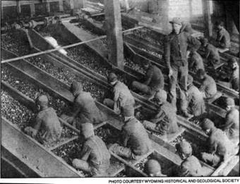
Industrial Workers
Growth of corporations led to increase in both white-collar and blue-collar positions
Higher paying jobs → increase demand for services → increase service sector
Overall impact:
More wage earners = more spending → expanding middle class
Wage Earners
By 1900, 2/3 of Americans worked in wage jobs
Large numbers of of immigrants kept wages low
“iron law of wages”
Most did not earn enough to survive
Families depended on income of women and children
Working Women
By 1900, 1 in 5
Only 5% of married
Gender roles extended to factories
Resulted in lower pay
Clerical work expanded w/white collar jobs
Notes:
Child Labor: https://progressivesapush4.wikispaces.com/Woman+and+Child+Labor
Breaker Boys: https://www.mca-marines.org/mcaf-blog/2011/08/29/warrant-officer-faustin-wirkus-breaker-boy-king

Slide 13
The New Industrialists
Positives
Revolutionized:
Travel, oil production, steel
Large volume of production:
drove down prices
created convenience products
created jobs
Philanthropy
Museums, higher education
Made America top industrial producer in the world
Made massive profits at expense of workers (exploitative)
Annual salaries were more than anyone could spend (or had ever made before)
lived opulently lavish lifestyles
Fostered poor working conditions (resistant to the expense of correcting them)
Monopolized trade to regulate prices (and increase profits)
Negatives

Slide 14
Attempts to Organize National Unions
National Labor Union (1866)
Goals:
Higher wages
8-hour workday
Failed during depression (1873-1877)
Knights of Labor (Powderly, 1869)
Unskilled
Included African Americans and Women
Goals:
Worker cooperatives, abolish child labor, abolish trusts
Strategy: strikes
American Federation of Labor (Samuel Gompers, 1886)
Skilled workers
Created associations of trade workers
Discouraged membership of women, immigrants, and minorities
Unionism
Better hours, conditions, wages
Strategies: strikes and collective bargaining
Notes:
http://explorepahistory.com/hmarker.php?markerId=1-A-3BE

Slide 15
The Struggle of Organized Labor
Labor Discontent
Poor conditions, long hours, low pay
Workers easily replaceable
Industrial Warfare
Lockouts, blacklists, strike-breakers, court injunctions
Great Railroad Strike of 1877
Began with B & O Railroad and spread to 11 states and 500,000 workers from other industries
President Hayes forced to call in troops to end strike. Results:
Millions in damages and over 100 dead
Some employers began to address workers’ grievances
Strengthened resolve for organized labor
Notes:
Great Railroad Strike: http://libcom.org/history/1877-the-great-railroad-strike

Slide 16
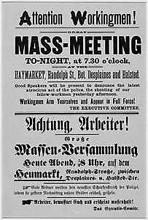
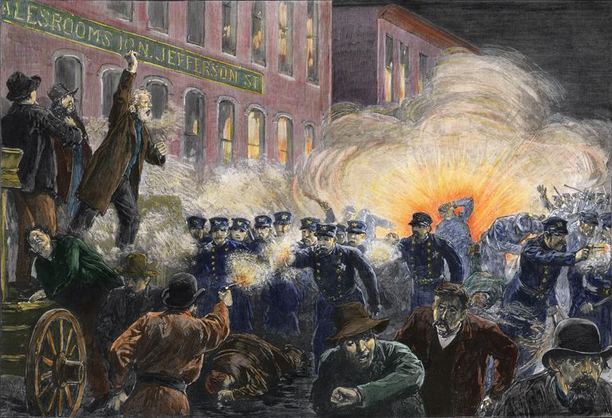
Major Strikes
Haymarket Riot (Chicago, 1886)
May Day strike at McCormick plant
Blamed on Knights of Labor
Became symbol of anarchist movement
Homestead Strike (Pittsburgh, 1892)
Frick vs. steel workers
Use of Pinkertons & strikebreakers
Failure
Pullman Strike (Chicago, 1894)
American Railway Union (Debs)
Cleveland sent army and federal court issues injunction – mail service
Led to formation of American Socialist Party (1900)
Impact of Strikes
Limited success, mostly failures
By 1900, only 3% of workers belong to unions
Notes:
Homestead Strike: http://explorepahistory.com/hmarker.php?markerId=1-A-3BE
Debs: http://2012books.lardbucket.org/books/united-states-history-volume-2/s06-02-national-politics-and-the-popu.html

Slide 17
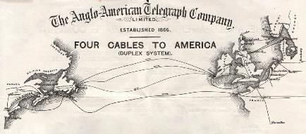
Technology and Innovations
Inventions
Telegraph
Morse (1844)
Field
Transatlantic cable (1866)
Conveniences
Typewriter (Remington, 1867)
Telephone (Bell, 1876)
Cash register (1879)
Adding machine (1888)
Kodak Camera (Eastman, 1888)
Safety blade (Gillette, 1895)
Notes:
Laying the transatlantic: http://www.canadaka.net/achievements/33-the-first-submarine-transatlantic-telephone-cable-system.html
Cables Map: http://atlantic-cable.com/CableCos/AngloAmerican/

Slide 18
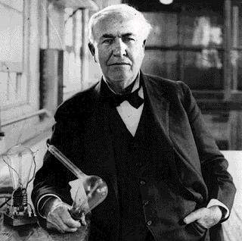
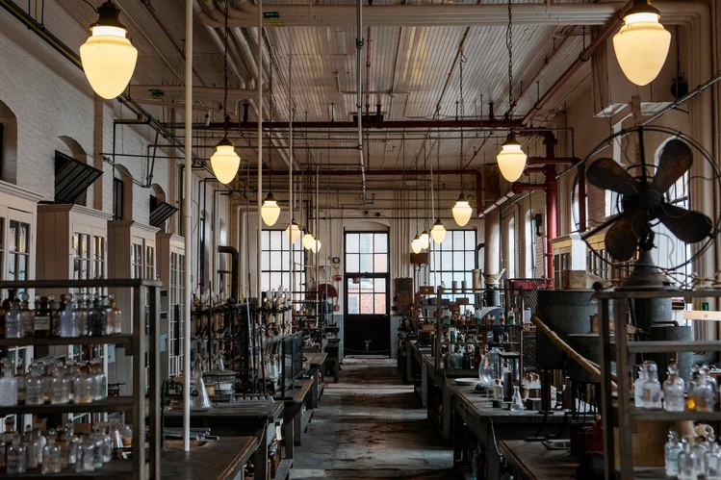
“Let There Be Light”
The “Wizard of Menlo Park”
More than 1,000 inventions
Vote-recording machine
Phonograph
Mimeograph
Motion-picture
Light bulb
Edison vs. Westinghouse
Direct current vs. alternating current
Impact:
Westinghouse wins contract for World’s Columbian Exhibition, 1893
Electrified cities
Streets, streetcars, subways, machinery, and appliances
Notes:
Edison vs. Westinghouse: http://www.smithsonianmag.com/ist/?next=/history/edison-vs-westinghouse-a-shocking-rivalry-102146036/
Picture is a link to video of electrocution: http://www.youtube.com/watch?v=VD0Q5FeF_wU

Slide 19
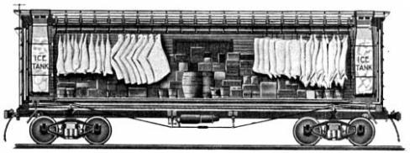
Marketing Consumer Goods
Department Stores
Cities
RH Macy’s (NY)
Marshall Field’s (Chicago)
Rural America
Woolworth’s
RFD (Rural Free Delivery)
Sears-Roebuck
Montgomery Ward
Transportation
Packaged foods
Kellogg and Post
Refrigerated Car (Swift)
Mass produced meats/vegetables
Advertising
Birth of the consumer culture
Notes:
Sears Image: http://upload.wikimedia.org/wikipedia/commons/3/3b/Sears,_Robuck_%26_Co._letterhead_1907.jpg
Battle of Battle Creek Link: http://www.digitaldeliftp.com/LookAround/advertspot_kelloggs.htm
Swift Refrigerator Car: http://historyproject802.wikispaces.com/Gustavus+Swift

