Slide 1
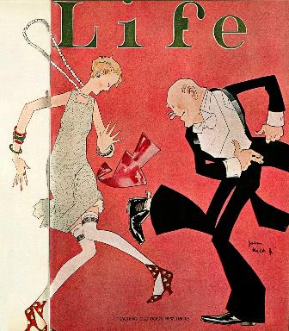
The Modern Era of the 1920’s
The United States During the “Jazz Age”
Notes:
Image: http://841socialstudies.wikispaces.com/The+Roaring+20's

Slide 2
Themes of the “Roaring Twenties”
Social
Fundamentalism vs. Modernity
Start of Mass Culture
Political
Isolationism
Limited Government
Economic
Consumerism
Unrestricted and Uncontrolled Expansion

Slide 3
Essential Questions
The 1920’s were a period of new and changing attitudes on the one hand and traditional values and nostalgia on the other. What led to this tension between old and new AND in what ways was the tension manifested?
To what extent was American foreign policy during the 1920’s a continuation of past policy and to what extent was it a departure?

Slide 4
Politics: Republican Control
Business Doctrine
Calvin Coolidge: “The business of America is business”
Weakening of Regulatory Agencies
Business friendly administrations and Congress
Sympathetic courts
Notes:
Mellon, Kellogg, Coolidge, Taft: https://kaiology.wordpress.com/tag/andrew-mellon/

Slide 5
The Harding Administration
A “Return to Normalcy”
The “Ohio Gang”
A Few Good Choices
Hughes (Sec. State), Hoover (Commerce), Mellon (Treasury), Taft (SCOTUS)
Domestic Policy
Reduced Income Tax
Increased Tariff (Fordney-McCumber, 1922)
Bureau of the Budget
Pardoned socialist leader Eugene V. Debs
Notes:
Image: http://www.granger.com/results.asp?inline=true&image=0041961&wwwflag=4&itemx=2

Slide 6
The Downfall
A Few Bad Choices
Albert B. Fall (Interior), Harry Daugherty (Attorney General)
Scandals
Bribery (Daugherty)
Teapot Dome (Fall)
Death (August 1923)
Notes:
Teapot Dome: http://www.britannica.com/EBchecked/topic/585252/Teapot-Dome-Scandal
Quote: http://izquotes.com/quote/79361

Slide 7
The Presidency of Calvin Coolidge
“Silent Cal”
The Election of 1924
Coolidge (R) vs. Davis (D) vs. LaFollette (Progressive)
Vetoes and Inaction
Cut spending
Vetoes:
Bonuses for WWI Vets
McNary-Haugen (1928)
Notes:
Map: http://periodicpresidents.com/research/election-maps/
Cartoon: http://cariart.tripod.com/cartoon-3.html

Slide 8
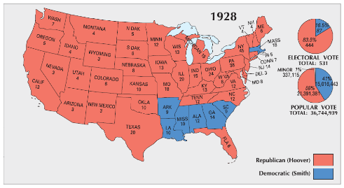
The Election of 1928
Herbert Hoover (R)
Administrative roles under three previous presidents
Alfred E. Smith (D, NY)
Catholic, a “wet” (anti-Prohibition)
Hoover’s Quote Upon Receiving the Republican Nomination (August 11, 1928):
“We in America today are nearer to the final triumph over poverty than ever before in the history of any land... We have not yet reached the goal, but given a chance to go forward with the policies of the last eight years, and we shall soon with the help of God be in sight of the day when poverty will be banished from this nation.”
Notes:
Map: http://periodicpresidents.com/research/election-maps/
Cartoon: http://www.patheos.com/blogs/mcnamarasblog/2012/10/anti-catholic-cartoon-of-the-week-1928.html

Slide 9
Economics of the “Roaring Twenties”
Effects of Government Policy and the Birth of a Consumer Culture

Slide 10
Economic Development
Characteristics:
Immediate Post-War Recession (1921)
Lengthy Business Prosperity (1922-1928)
High Standard of Living
Low Unemployment (less than 4%)
Increased wages for middle and working classes
Although prosperity did not extend to farmers and the working poor
Economic Disaster (1929)
Notes:
Cartoon: http://americainclass.org/sources/becomingmodern/prosperity/text1/text1.htm

Slide 11
Causes of Business Prosperity
Increased Productivity
Efficiency (Taylor)
Mass Production & Assembly Line (Ford, 1914)
Energy Technologies
Petroleum
Oil = 23% of energy
Electricity (300% increase in use)
Motors in factories, appliances in homes
Government Policy
Corporate tax cuts, subsidies, and lax enforcement of antitrust laws
Tax cuts for the wealthy (“Trickle-down” – Mellon)
Federal Reserve Policies
Notes:
Image: http://www.lib.msu.edu/branches/dmc/tribune/detail.jsp?id=12600

Slide 12
A Consumer Economy
New Appliances
Refrigerators, vacuums, washing machines
The Automobile
Industrial and Cultural Revolution
Increasing Sales
Advertising
Buying on Credit
Installment Plans
Notes:
Image: http://bulcranium.blogspot.com/2012/08/hilarious-early-deodorant-ads.html
Exercise using advertising: Have students research an ad from the 1920’s and find an ad from today to compare it to.

Slide 13
Impact of the Automobile
Economic
Affected Industries:
Gas, Steel, Glass, Rubber, Roads and Travel
Replaced railroads
Social
Independence for Women and Teens
Shopping, travel, commuting
Cultural
Iconic
Advent of the “Big Three”
Ford, GM, Chrysler
Notes:
Ad: http://www.anythingaboutcars.com/1920scars.html
Stress importance of advertising and targeted audience.

Slide 14
Economic Problems
Farm Problems
Post War Problems
Massive debt
Although new technology increased production, issues with prices and loans not addressed
Labor Problems
Declining union membership
Result of welfare capitalism and association of unions with socialism
Ineffectiveness of strikes
United Mine Workers (John L. Lewis)
Conservative court injunctions
Notes:
Cartoon: http://en.wikipedia.org/wiki/United_Mine_Workers

Slide 15
A New Culture
Social and Cultural Developments of the “Jazz Age”

Slide 16
Causes
Consumer
Culture
Advertising
Mass Consumption
New
Technology
Electricity
Radio and Automobile
Sports and Film
Arts and Literature
Entertainment
Notes:
Image: https://emilysvm.files.wordpress.com/2014/09/the-roaring-twenties-1-638.jpg

Slide 17
Entertainment
The Radio (1920)
National Syndication
NBC (1924)
CBS (1927)
Promoted Uniformity and Advertising
Hollywood
“Talkies” (Jazz Singer, 1927)
“Movie Stars”
Chaplin, Garbo, Valentino
Movie “Palaces”
80 million tickets weekly
Popular Heroes
Sports: Dempsey, Ruth, Thorpe, Jones
Aviation: Lindbergh, Earhart
Notes:
Hollywood Sign: http://www.reddit.com/r/pics/comments/15uncq/original_hollywood_sign_circa_1920s/
Stamps: http://www.moviecard.com/zamerican/exhibit/exh-moviestamppicturesP.html

Slide 18
Gender Roles, Family, and Education
Women at Home
Gender roles reinforced
New appliances didn’t change role of homemaker
Women in the Labor Force
Following war, went back to largely clerical jobs
Receiving lower wages than male counterparts
Revolution in Morals
Psychology (Freud)
Old vs. New
Music, movies, fashion, smoking, sex
Birth Control
The “Flapper”
Marriage and Divorce Rates
Education
Importance of schooling (high school: 25%)
Path toward assimilation for immigrants
Notes:
“Bernice Bobs Her Hair”: http://www.saturdayeveningpost.com/2011/06/25/art-entertainment/art-haircut.html

Slide 19
The Arts
Literature
The “Lost Generation”
American expatriates protesting mass culture/consumerism
Poets: T.S. Eliot, e.e. cummings, Ezra Pound
Writers: F. Scott Fitzgerald, Ernest Hemingway, Sinclair Lewis
Examples: The Great Gatsby (Fitzgerald); Babbitt and Main Street (Lewis)
Art and Architecture
Art Deco
Artists: Hopper, Wood, Benton
Musical Theater
Rhapsody in Blue and Porgy and Bess (Gershwin)
Notes:
Gatsby: http://www.tcdailyplanet.net/arts/2013/05/10/great-gatsby-and-great-pumpkin-writers-who-wrestled-their-minnesota-pasts
Lost Generation: http://dfuse.in/whathowwho/what-the-hell-is-the-lost-generation-2/

Slide 20
The Harlem Renaissance
Migration of Jazz
South (New Orleans) → Up the River (St. Louis & Chicago) → To the City (New York)
Poets and Musicians
Countee Cullen, Claude McKay, Langston Hughes, Zora Neale Hurston
Duke Ellington, Louis Armstrong, Bessie Smith, Billie Holiday
United Negro Improvement Association (1916)
Marcus Garvey’s “Back to Africa Movement”
Notes:
Cotton Club: http://bloggingtonybennett.com/duke-ellington-and-the-harlem-renaissance/

Slide 21
Values in Conflict
Religion
Modernism vs. Fundamentalism
Manifestations:
Revivalists
Billy Sunday, Aimee Semple McPherson
The Scopes “Monkey” Trial (Dayton, TN - 1925)
Evolution on Trial
Clarence Darrow vs. William Jennings Bryan
Notes:
Video of Aimee Semple McPherson -- Source: https://www.youtube.com/watch?v=U0bXH1YgKf4

Slide 22
Views of the Scopes Trial
Notes:
Pied Piper Cartoon: http://www.kevincmurphy.com/uatw-culture-scopes.html
Thou Shall Not Think: http://www.tumblr.com/search/Monkey+Trial

Slide 23
Prohibition
18th Amendment (1919)
Volstead Act (prohibited production, sale and consumption of alcohol)
Defying the Law
Bootleggers and Speakeasies
Organized Crime
Al Capone
Alcohol consumption actually increased in cities during Prohibition
Political Discord and Repeal
“Noble Experiment” created more problems than it solved
Decline in overall alcoholism and alcohol-related deaths
Increased criminal activity and other vices: prostitution, gambling, narcotics
21st Amendment (1933) – overturned 18th
Notes:
False Fascia Lumber Truck: http://www.stashvault.com/lumber-truck-secret-compartment-moonshine/prohibition-agents-inspecting-bootleggers-truck/

Slide 24
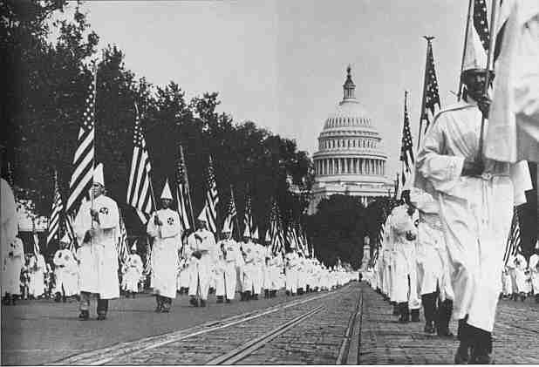
Nativism
Government Policies
Emergency Quota Act (1921)
3% of 1910 Census
1924 Immigration Act
2% of 1890
National Origins Act
Sacco and Vanzetti (1921)
Sentenced to death
Rebirth of the KKK
Birth of a Nation (D.W. Griffith, 1915)
Over 5 million members by 1925
Tactics:
Targeted “Un-Americans”
Violence and threats
Political influence
Decline:
Fraud, corruption, and vice
Notes:
Quota Cartoon: http://pixgood.com/immigration-quota-cartoon.html
KKK Rally in Washington: http://www.d.umn.edu/cla/faculty/tbacig/studproj/is3099/jazzcult/20sjazz/race.html

Slide 25
American Foreign Policy
The Fiction of Isolation and the Emergence of a World Power

Slide 26
Disarmament and Peace
Washington Conference (1921)
Five-Power Treaty
Four-Power Treaty
US, France, Great Britain, and Japan
Nine-Power Treaty
Respect Open Door Policy in China
Kellogg-Briand Pact (1928)
Outlawed use of war to achieve national goals
Ineffective: permitted defensive wars and failed to provide enforcement
Notes:
Kellogg-Briand Cartoon “Innocents Abroad”: http://www.cartoons.ac.uk/record/GS0122

Slide 27
Business and Diplomacy
Latin America
US oil investors in Mexico (1927)
Troops sent to Nicaragua and Haiti, pulled from the Dominican Republic (1924)
US investments doubled from 1919-1929
Middle East
Negotiation for oil-drilling rights
Tariff Policy
25% (Fordney-McCumber)
European nations retaliate with own tariffs
War Debts and Reparations
Dawes Plan
Notes:
Cartoon: http://rbarton.weebly.com/war-reparations.html

Slide 28
Legacy of the “Roaring Twenties”
New Technology and advances in the arts and entertainment lead to birth of a mass culture
Xenophobia and disillusionment with war leads to nativism and isolation
Consumerism and advertising, coupled with loose government regulation leads to economic boom (mostly false growth).
Notes:
Chrysler Building: http://www.playle.com/listing.php?i=BOOTS39534

Slide 29
Understanding the 1920’s by using the Streets of New York:
Entertainment
Advertising
Finance
Shopping

